Slide 1


《经济学原理》
（微观经济学原理部分）
主讲人：周豫
第21章：消费者选择理论
哈尔滨工业大学（深圳）
经济管理学院
THE HITSZ SCHOOL OF ECONOMICS AND MANAGEMENT

Slide 2

本章回答如下4个问题：
预算约束如何代表消费者能够买得起的选择？
无差异曲线如何代表消费者的偏好？
什么决定了消费者如何在两种商品之间分配资源？
消费者选择理论如何解释诸如消费者储蓄多少或提供多少劳动力等决策？

Slide 3
前言
回忆第一章中的经济学十大原理之一:
人们面临权衡取舍
当消费者多买某种物品时，他只能余下更少的收入去买更少的其他物品
工作时间更长意味着更多收入、更多消费，但更少的闲暇时间
减少储蓄会增加今天的消费，却会减少未来的消费
本章我们考察消费者面临这些问题如何做出选择。

Slide 4
预算约束： 消费者能买得起什么
例如：甲把他的收入花在两种物品上：鱼和芒果
一个"消费组合"是一个特定的物品组合，比如：40条鱼+300个芒果
预算约束：消费者可以支付得起的消费组合的限制。

Slide 5
习题：预算约束
甲的收入：1200元
价格：P_{F}=4元/每条鱼，P_{M}=1元/每个芒果
如果甲将所有的收入都拿来买鱼，那他能买多少条鱼?
如果甲将所有的收入都拿来买芒果，那他能买多少个芒果?
如果买了100条鱼，那他还能买多少芒果？
将A-C消费组合画在图上，其中横轴衡量鱼的数量，纵轴衡量芒果的数量，并把这些点连接起来。

Slide 6
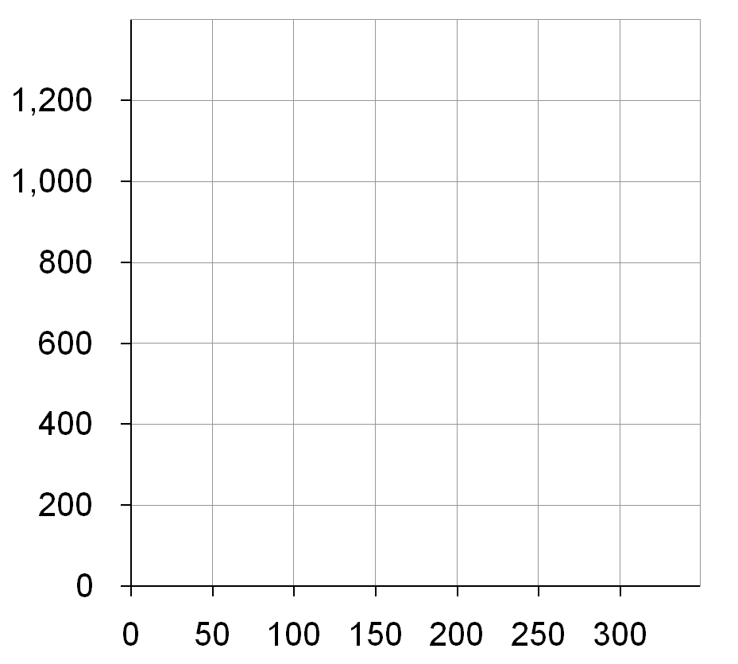
习题：参考答案
D. 预算约束表明他可以购买得起的消费组合
芒果的数量
1200/4=300条鱼
1200/1=1200个芒果
100条鱼花400元，剩下的800元买800个芒果
B
C
A
鱼的数量

Slide 7
预算约束线的斜率
预算约束线的斜率等于X轴上产品的相对价格
芒果的数量
从C到D,
“向上”=-200个芒果
“向右”=+50条鱼
斜率=-4
甲为了得到1条鱼必须放弃4个 芒果
C
D
鱼的数量

Slide 8
习题：预算约束线
甲的预算约束线在下列情况会发生什么样的变化：
他的收入减少到800
芒果的价格上升到P_{M}=2元/每个芒果
鱼的数量

Slide 9
习题：参考答案
收入减少使预算约束线向下移动
芒果的数量
A：现在能买
800/4=200条鱼
或
800/1=800个芒果
或
这两者之间的任意组合
鱼的数量

Slide 10
习题：参考答案
一种物品价格的上升使预算约束线向内转动
芒果的数量
B：仍然能买300条鱼.
但他现在只能买1200/2 = 600个芒果.
注意：
斜率变小，鱼的相对价格现在是两个芒果
鱼的数量

Slide 11
偏好：消费者想要什么
一条无差异曲线
无差异曲线：
一条表示给消费者相同满足程度的消费组合的曲线。
在I₁上的A、B或者其他消费组合，使甲感到同样快乐：他在这些组合之间无差异。
芒果的数量
B
A
I₁
鱼的数量

Slide 12
无差异曲线的四个特征
1. 曲线向右下方倾斜
一条无差异曲线
芒果的数量
如果鱼的数量减少，那芒果的数量必须增加，以使甲保持相同的满足程度。
B
A
I₁
鱼的数量

Slide 13
无差异曲线的四个特征
2. 消费者对较高无差异曲线的偏好大于较低无差异曲线
几条无差异曲线
芒果的数量
相对于I₁上的每个消费组合(如消费组合A)，甲更喜欢I₂上的每个消费组合(如消费组合C)
他对I₁上的每个消费组合(比如组合A)的偏好要大于I₀上的每个消费组合(比如D)
C
D
A
I₂
I₁
I₀
鱼的数量

Slide 14
无差异曲线的四个特征
3. 无差异曲线不相交
芒果的数量
无差异曲线
由于消费组合B的两种物品的数量都大于消费组合C的两种物品的数量，相对于C , 甲会更偏好B。
然而，甲却是在B与C之间无差异：因为他在A与C之间无差异(都在I₄)，他在A与B之间无差异(两个都在I₁)
B
C
A
I₁
I₄
鱼的数量

Slide 15
无差异曲线的四个特征
4. 无差异曲线凸向原点.
芒果的数量
相对于消费组合B, 甲在消费组合A时，愿意放弃更多的芒果来交换一条鱼。因为B处鱼多，不值钱。
A
6
1
B
2
1
I₁
鱼的数量
Notes:
Hurley has more fish at B than at A, so an extra fish would be less valuable at B than at A.

Slide 16
边际替代率
MRS =无差异曲线的斜率
芒果的数量
边际替代率(MRS): 消费者愿意以一种物品交换另一种物品的比率
A
MRS =
6
甲的边际替代率是他愿意为多得到1条鱼所愿意放弃的芒果数量
1
B
MRS =
2
沿着无差异曲线向右下方移动，MRS不断减少。
1
I₁
鱼的数量
Notes:
At A, Hurley has few fish, so an additional fish is very valuable to him.
At B, Hurley already has lots of fish, so an additional one is not as valuable to him.

Slide 17
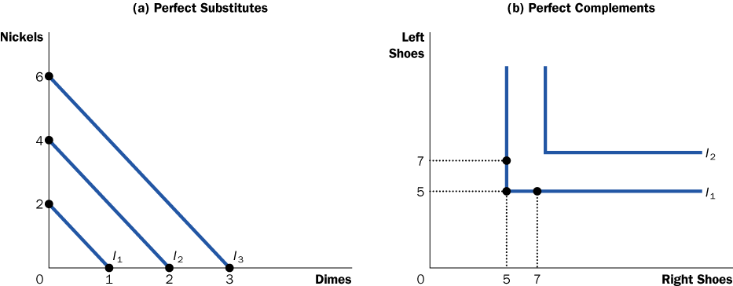
一个极端的例子：完全替代品
完全替代品：无差异曲线为直线的两种物品，有不变的MRS
例如：5分硬币(Nickel)与1角硬币(Dimes)
消费者总是愿意以2个5分硬币来交换1个1角硬币。
Notes:
16
It is hard to think of examples of perfect substitutes. (Even nickels and dimes are probably not perfect substitutes: I’d rather carry 10 dimes in my pocket than 20 nickels.)
But it’s easy to think of examples that are close substitutes, and therefore are likely to have indifference curves that are not very bowed:
1) Movies (at the movie theater) and videos at home. A consumer might be willing to trade two videos for one night at the movies.
2) Coke and Pepsi (for consumers who do not perceive much difference between them).
3) Vacations in Hawaii and vacations in the Bahamas.

Slide 18
另一个极端例子：完全互补品
完全互补品：无差异曲线为直角形的两种物品。
例如：左脚鞋，右脚鞋
{7只左脚鞋，5只右脚鞋}等同于
{5只左脚鞋，5只右脚鞋}
Notes:
17
Again, It is hard to think of examples of perfect complements. But it’s easy to think of examples that are good though not perfect complements, and therefore are likely to have indifference curves that are very bowed:
1) Tickets to rock concerts and parking at the arena in which the concert takes place.
2) Hot dogs and hot dog buns.
3) Brewed Starbucks coffee and 20 spoons of sugar (If you don’t get this one, you probably haven’t tried brewed Starbucks coffee!).

Slide 19
不那么极端的例子：近似替代品与近似互补品
百事可乐的数量
热狗面包的数量
近似互补品的无差异曲线非常弯曲
近似替代品的无差
异曲线不是很弯曲
可口可乐的数量
热狗的数量
Notes:
When the two goods are close but not perfect substitutes (like Coke and Pepsi), indifference curves are slightly bowed.
When the two goods are close but not perfect complements (like hot dogs and buns), indifference curves are very bowed, having a very sharp (but not quite 90-degree) angle.
Later in this PowerPoint chapter, an Active Learning exercise asks students to illustrate the substitution effect for these two cases. They will see that a relative price change causes a much bigger movement along an indifference curve when the goods are substitutes than when they are complements.

Slide 20
最优化：消费者选择什么
最优点：
甲负担得起的所有消费组合中最偏好的那个消费组合
芒果的数量
A 是最优点：预算约束线上位于最高可能的无差异曲线上的一点
1200
甲偏好B胜过A，但他买不起B
B
A
600
甲买得起C和D，但A在更高的无差异曲线上
C
D
150
300
鱼的数量
Notes:
Simply put, optimization means buying the bundle that makes the consumer happiest, given his or her income.

Slide 21
最优化：消费者选择什么
消费者最优化是“考虑边际量”的另一个例子
芒果的数量
在最优点：无差异曲线的斜率等于预算约束线的斜率:
1200
MRS = P_{F}/P_{M}
A
600
鱼的边际价
值(用芒果来衡量)
鱼的价格 (用芒果来衡量)
150
300
鱼的数量
Notes:
Consumer optimization is another example of “thinking at the margin.”
Remember that MRS = marginal value of the good on the X-axis (fish) in terms of the good on Y-axis (mangos).
If MRS > Pf/Pm, the value of another fish is greater than its cost, so Hurley can make himself happier by decreasing his mango purchases and using the proceeds to buy another fish.
If MRS < Pf/Pm, the value of another fish is less than its cost, so Hurley should move along his budget line to a bundle with less fish and more mangos to make himself happier.

Slide 22
收入增加的影响
芒果的数量
收入增加使预算约束线向外移动
如果这两种物品都是“正常物品”, 甲两种物品都会多买。
B
A
鱼的数量
Notes:
In Active Learning 2, students determined that a fall in income shifts the budget constraint downward. They should readily accept, then, that an increase in income shifts the budget line upward/outward.

Slide 23
0
习题3：低档物品与正常物品
收入增加会使正常物品的需求量增加，低档物品的需求量减少
如果鱼是正常物品，而芒果是低档物品（参考香蕉对于海南省人民来说）
用图形表示出收入增加对鱼与芒果的最优消费量的影响
Notes:
22

Slide 24
习题3：参考答案
芒果的数量
如果芒果是低档物品，新的最优消费组合会减少芒果的消费量。
A
B
鱼的数量
Notes:
In Active Learning 2, students determined that a fall in income shifts the budget constraint downward. They should readily accept, then, that an increase in income shifts the budget line upward/outward.

Slide 25
价格变动的影响
最初,
P_{F} = 4元
P_{M} = 1元
芒果的数量
1200
原来的最优点
如果P_{F}下降到2元
预算约束线向外移动，甲会买更多的鱼和更少的芒果.
新最优点
600
500
150
300
600
鱼的数量
350
Notes:
In Active Learning 2, students determined that an increase in the price of a good pivots the budget constraint inward. Here, the price of a good is falling, so the budget line pivots outward.

Slide 26
0
收入效应与替代效应
鱼价格下降对两种物品的最优消费量有两种效应：
收入效应：鱼价格下降增加了甲收入的实际购买能力，使得他能够购买更多的芒果和鱼。
替代效应：鱼价格下降使芒果相对于鱼的价格上升，会使甲买更少的芒果，购买更多的鱼
注意：对芒果的净效应并不确定
Notes:
25

Slide 27
收入效应与替代效应
原来的最优点在A.
P_{F} 下降.
替代效应: 从A到B，买更多的鱼和更少的芒果
收入效应: 从B到C，买更多的这两种物品
芒果的数量
在这个例子中，对芒果的净效应是负的。
A
C
B
鱼的数量
Notes:
This diagram decomposes the movement from the old optimum (A) to the new one (C) into two parts.
The first part, from A to B, represents the substitution effect. It shows the change in the optimal bundle due to the relative price change, holding constant the consumer’s level of well-being.
The second part, from B to C, represents the income effect. It shows the change in the optimal bundle due to the increase in the purchasing power of the consumer’s income. The dashed line through point B is parallel to the new budget line through point C, indicating that we are holding relative prices constant to see how the increase in income affects the optimal bundle.

Slide 28
0
习题4：两种情形中的替代效应
你认为哪种物品的替代效应会更大，完全替代品还是完全互补品?
在一张图上画出百事可乐与可口可乐的无差异曲线，在另一张图上画出热狗与热狗面包的无差异曲线
每张图中，表示出相对价格变动的影响(保持消费者在最初的无差异曲线上)
Notes:
27

Slide 29
0
习题4：参考答案
在两张图中，相对价格变动相同的幅度
但替代品的替代效应大于互补品
百事可乐的数量
热狗面包数量
A
A
B
B
可口可乐的数量
热狗数量
Notes:
28

Slide 30
推导甲对鱼的需求曲线
A:当P_{F} = 4元，甲购买150条鱼.
B:当P_{F} = 2元, 甲购买350条鱼.
芒果的数量
鱼的价格
A
4
A
B
B
2
D_{F}
150
350
150
350
鱼的数量
鱼的数量
Notes:
This slide shows that the familiar demand curve we’ve been using all semester comes from consumer optimization.

Slide 31
应用1:吉芬物品
所有的物品都遵守需求定理吗?
假设有两种物品：土豆和肉，其中土豆是低档物品
如果土豆的价格上升，
替代效应：少买土豆
收入效应：多买土豆
如果收入效应>替代效应，那土豆是一种吉芬物品：价格上升引起需求量增加的物品。
Notes:
30
Why the interest rate determines the relative price of current in terms of future consumption:
If you reduce current consumption by $1, and save this $1, then your future consumption will rise by $(1 + r), where r denotes the interest rate.
Similarly, if you wish to increase current consumption by $1, then you must sacrifice the $(1 + r) that you would have been able to consume in the future.
Notice that the slide does not say “the interest rate equals the relative price…”. In fact, the relative price of current in terms of future consumption (and also the slope of the budget constraint) equals (1 + r), not r.

Slide 32
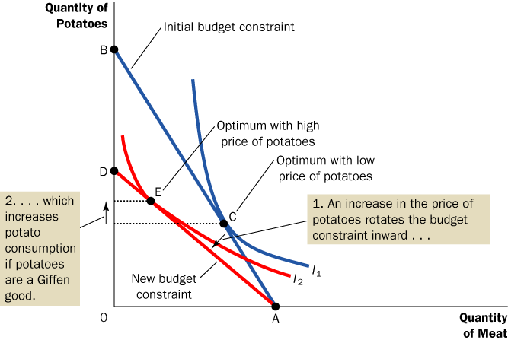
应用1:吉芬物品
Notes:
31
An increase in the price of potatoes rotates the budget line inward.
The substitution effect would cause the consumer to buy fewer potatoes. Imagine moving down along indifference curve I₁ until reaching the point where its slope just equals the slope of the new budget line. At that point, demand for potatoes is lower, because consumers are substituting meat for potatoes.
But if potatoes are an inferior good, the income effect causes demand for potatoes to rise: the price increase makes the consumer generally worse off. The consumer responds by buying less meat (the normal good) and more potatoes (the inferior good).
If potatoes are a Giffen good, the income effect exceeds the substitution effect, so the net effect of a price increase on demand for potatoes is positive!!!
As the book notes, Giffen goods are extremely rare—if they exist at all.

Slide 33
应用2:工资与劳动供给
预算约束线：
表明一个人消费与闲暇的权衡取舍
取决于她如何分配闲暇时间和工作时间
1小时闲暇的相对价格是她1小时工资能购买的消费量
无差异曲线：
表示能给她相同满意程度的消费和闲暇的“消费组合"
Notes:
32
Why the interest rate determines the relative price of current in terms of future consumption:
If you reduce current consumption by $1, and save this $1, then your future consumption will rise by $(1 + r), where r denotes the interest rate.
Similarly, if you wish to increase current consumption by $1, then you must sacrifice the $(1 + r) that you would have been able to consume in the future.
Notice that the slide does not say “the interest rate equals the relative price…”. In fact, the relative price of current in terms of future consumption (and also the slope of the budget constraint) equals (1 + r), not r.

Slide 34
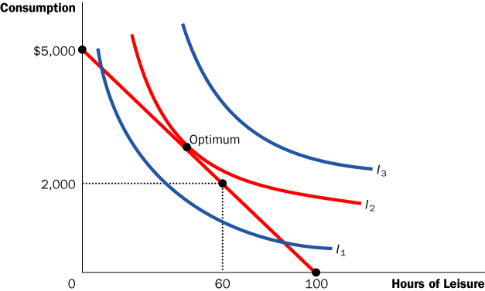
应用2:工资与劳动供给
在最优点，闲暇与消费的边际替代率等于工资
Notes:
33
Here, the marginal rate of substitution measures the marginal value of an hour of leisure, in terms of (dollars’ worth of) consumption.
The slope of the budget line simply equals the wage: each additional hour of leisure requires working one fewer hour, which causes consumption to fall by an hour’s wages.
At the optimum, the marginal value of leisure (in terms of consumption) must equal the relative price of leisure (in terms of consumption), or the wage.
If MRS > wage, then the value of leisure is greater than its price, so take more leisure (and work fewer hours) to raise happiness.
If MRS < wage, then the value of leisure is less than its price, so take less leisure (and work more hours) to raise happiness.

Slide 35
应用2:工资与劳动供给
工资增加对劳动的最优供给量有两种效应：
替代效应(SE)：高工资使闲暇相对于消费更昂贵，因此会减少闲暇时间，那就是说，会增加劳动供给量
收入效应(IE)：更高的工资使她能购买更多的两种物品，因此会增加闲暇时间，那就是说，会减少劳动供给量
Notes:
34
Why the interest rate determines the relative price of current in terms of future consumption:
If you reduce current consumption by $1, and save this $1, then your future consumption will rise by $(1 + r), where r denotes the interest rate.
Similarly, if you wish to increase current consumption by $1, then you must sacrifice the $(1 + r) that you would have been able to consume in the future.
Notice that the slide does not say “the interest rate equals the relative price…”. In fact, the relative price of current in terms of future consumption (and also the slope of the budget constraint) equals (1 + r), not r.

Slide 36
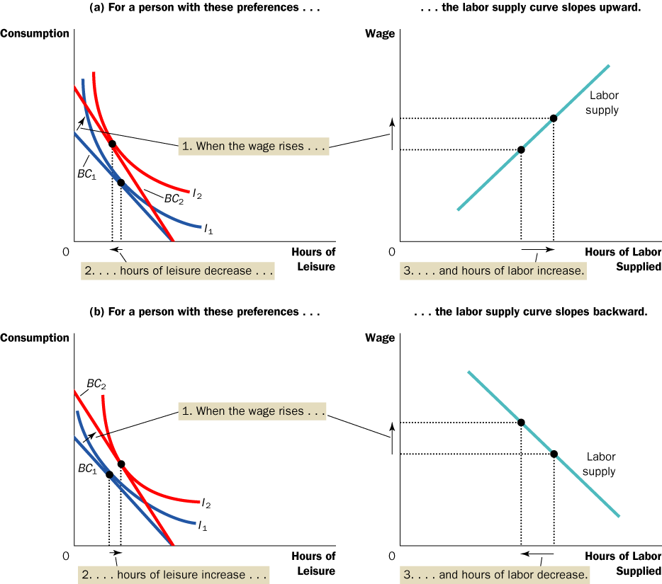
应用2:工资与劳动供给
工资增加，劳动供给量也增加
如果SE > IE
Notes:
35
A person with the preferences depicted in the left graph will have a positively-sloped labor supply curve, as shown in the right graph.

Slide 37
应用2:工资与劳动供给
工资增加，劳动供给量减少
如果SE<IE
Notes:
36
A person with the preferences depicted in the left graph will have a negatively-sloped labor supply curve, as shown in the right graph.

Slide 38
在现实世界中这可能发生吗
下述例子中劳动供给的收入效应非常强：
在过去的100多年间，技术进步增加了劳动需求和实际工资，而平均工作日却从每周6天减少为每周5天
当一个人获得巨额彩票奖金或继承了一笔遗产的同时，他的工资并没有改变——因此没有替代效应，但这样的人很可能会减少工作时间，意味着有很强的收入效应（来自巨额奖金收入）。
Notes:
37
Why the interest rate determines the relative price of current in terms of future consumption:
If you reduce current consumption by $1, and save this $1, then your future consumption will rise by $(1 + r), where r denotes the interest rate.
Similarly, if you wish to increase current consumption by $1, then you must sacrifice the $(1 + r) that you would have been able to consume in the future.
Notice that the slide does not say “the interest rate equals the relative price…”. In fact, the relative price of current in terms of future consumption (and also the slope of the budget constraint) equals (1 + r), not r.

Slide 39
应用3:利率与家庭储蓄
人的一生分为两个时期
时期1: 年轻，工作，挣100,000元，消费=100,000-储蓄量
时期2: 老年，退休，消费=时期1的储蓄+储蓄得到利息
利率决定“年轻时消费”与“年老时消费”的相对价格。
Notes:
38
Why the interest rate determines the relative price of current in terms of future consumption:
If you reduce current consumption by $1, and save this $1, then your future consumption will rise by $(1 + r), where r denotes the interest rate.
Similarly, if you wish to increase current consumption by $1, then you must sacrifice the $(1 + r) that you would have been able to consume in the future.
Notice that the slide does not say “the interest rate equals the relative price…”. In fact, the relative price of current in terms of future consumption (and also the slope of the budget constraint) equals (1 + r), not r.

Slide 40
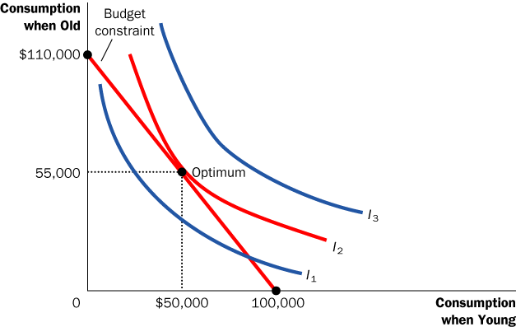
应用3:利率与家庭储蓄
预算约束线：利率10%
在最优点，当期消费与未来消费的边际替代率等于利率
Notes:
39
The marginal rate of substitution is the marginal value of current consumption in terms of future consumption; it tells you how much future consumption the person is willing to give up for a unit of current consumption.
If the consumer is optimizing, then the MRS must equal (1 + r): the marginal value of current consumption must equal the relative price of current consumption (both in terms of future consumption).
If MRS were not equal to (1 + r), then the consumer could increase his satisfaction by changing his level of saving (and hence, his “bundle” of current and future consumption).

Slide 41
0
习题5：利率变动的效应
假如利率上升
分别描述收入效应和替代效应对当期消费，未来消费以及储蓄的影响
Notes:
40

Slide 42
0
习题5：参考答案
利率上升
1.替代效应
相对于未来消费，当期消费变得更昂贵，当期消费减少，储蓄增加，未来消费增加
2.收入效应
能负担得起更多的当期和未来的消费，储蓄减少
Notes:
41

Slide 43
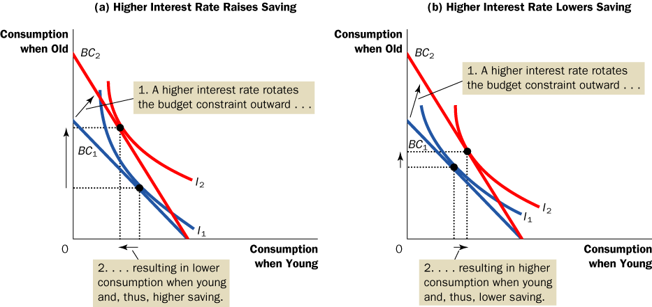
应用3:利率与家庭储蓄
在这个例子中，SE>IE, 储蓄增加
Notes:
42
The macro chapters of Mankiw’s Principles of Economics typically assume that saving is positively related to the interest rate, as depicted here.

Slide 44
应用3:利率与家庭储蓄
在这个例子中，SE<IE, 储蓄减少
Notes:
43
If the income effect is bigger than the substitution effect, then an increase in the interest rate would reduce saving, not increase it.

Slide 45
结论
人们并不是在画出预算约束线和无差别曲线之后，再来做消费决策
但他们力图在资源有限的情况下，做出能最大化他们满意程度的决策
本章的理论只是作为消费者如何做决策的一个比喻
它很好地解释了许多情况下的消费者行为，也为更高深的经济分析提供基础

Slide 46
总结
消费者预算约束线表示在其收入与物品价格为既定时，它可以购买的不同物品的可能组合。预算约束线的斜率等于这些物品的相对价格
收入增加使预算约束线向外移动，一种物品价格的变动使预算约束线发生转动

Slide 47
总结
消费者的无差异曲线代表其偏好。无差异曲线表示能使消费者同样满足的各种物品组合。消费者对较高无差异曲线上各点的偏好大于对较低无差异曲线上的各点
无差异曲线上任何一点的斜率是边际替代率——消费者愿意用一种物品交换另一种物品的比率

Slide 48
总结
消费者通过选择既在预算约束线上、又在最高无差异曲线上的一点来实现最优化。在这一点上，边际替代率等于两个物品的相对价格
当一种物品价格下降时，对消费者选择的影响可以分解为收入效应和替代效应

Slide 49
总结
收入效应是由于价格降低使消费者状况变好而引起的消费变动，它反映在从较低无差异曲线向较高无差异曲线的移动上
替代效应是由于价格变动鼓励更多地消费变得相对便宜的物品而引起的消费变动，它表现为沿着一条无差异曲线向有不同斜率的点的变动上

Slide 50
总结
消费者选择理论适用于许多情况。它可以解释为什么需求曲线有可能向右上方倾斜，为什么工资提高既可能增加也可能减少劳动供给量，为什么利率提高既可能增加也可能减少储蓄。

